Slide 1
Identification of Foliar disease in apple trees using Deep supervised Learning.
Plant Pathology FGVC 2021 – A Kaggle Research code competition
Ashish Bodhankar,
Mataparthi Joshnanjani, and
Vineeta Dmello.
MS in Data Science – Spring 2021 Semester

Slide 2
The plant pathology FGVC 2021
1.) Expert‐annotated foliar images of Apple orchards, was made available to the Kaggle community for the Plant Pathology Challenge as part of the Fine‐Grained Visual Categorization (FGVC) workshop at the 2020 Computer Vision and Pattern Recognition conference (CVPR 2020).
2.) This year’s dataset has many more images. (~6X)
3.) More number of output classes (foliar diseases identified) than before.
4.) Participants were asked to use the image data set to train a machine learning model to classify disease categories and develop an algorithm for disease severity quantification.

Slide 3
What is Plant pathology FGVC 2021?
Premise?
The US Apple Industry’s annual worth – $15 Million – This industry experiences millions of dollars in annual loss due to a wide variety of reasons:-
They are under constant threat from many pathogens and insects. (fungal, bacterial, and viral pathogens).
biotic and abiotic stresses.
multi‐year impacts from the loss of fruit‐bearing trees.
The Impact - Depending on the incidence and severity of infections could be –
Unappealing cosmetic appearance, low marketability, and poor quality of fruit, to decreased yield or complete loss of fruit or trees

Slide 4
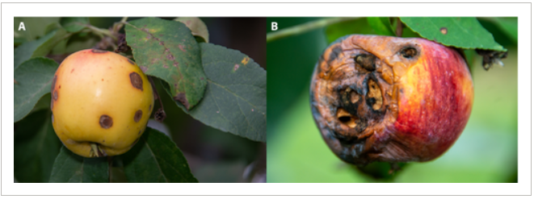
Objective – Abstract
Early pest and disease detection are critical for appropriate and timely deployment of disease and pest management programs.
Incorrect and delayed diagnosis can result in either excessive or inadequate use of chemicals, with increased production costs and increased environmental and health impacts.
In addition, misdiagnosis can result in either over‐ or under‐use of chemicals, leading to the emergence of resistant pathogen strains.

Slide 5
Objective
The main objective of this competition is to develop Machine Learning-based models to accurately classify a given leaf image from the test dataset to a particular disease category, and to identify an individual disease from multiple disease symptoms on a single leaf

Slide 6
How does the Dataset look?
23,000 high-quality RGB images VS 3600 images (FGVC 2020)
18,600 training images + image to label mapping (.csv file)
5000 test images are hidden and will be available once we submit our notebook on Kaggle
For now, we have decided to split the available 18,600 images further into Train and Validation set for building and evaluating Convolution Neural Networks.
IMAGES:- (large variations in visual symptoms)
Images clicked in different maturity stages and at different times of day.
Non uniform background
different light illumination during imaging

Slide 7
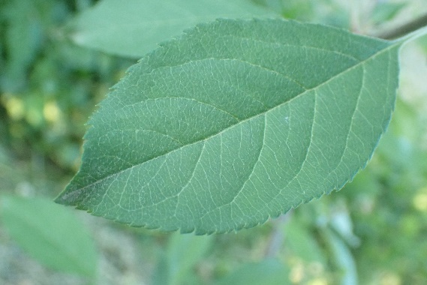
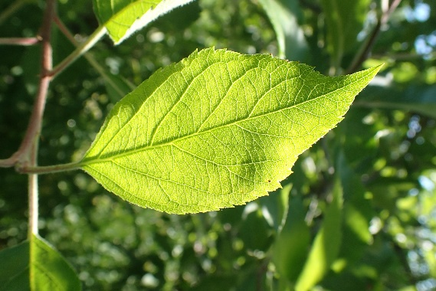
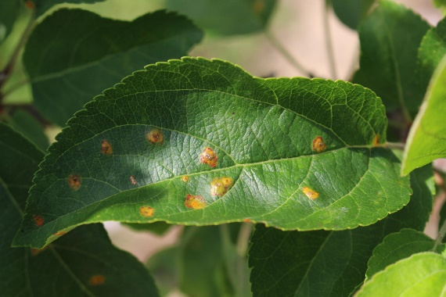
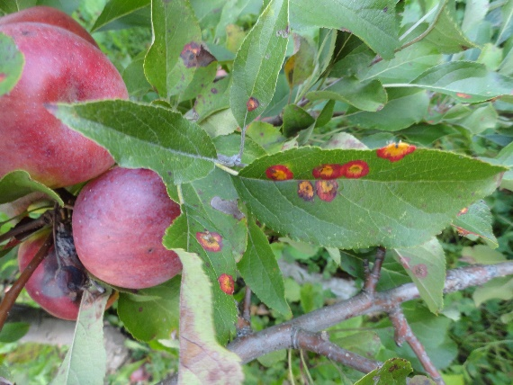
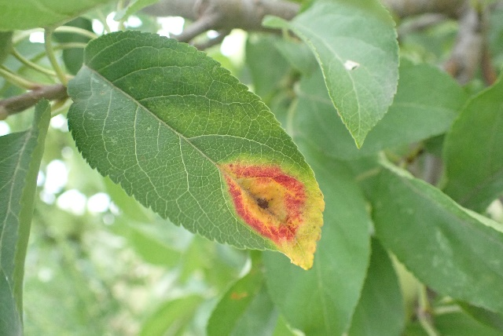
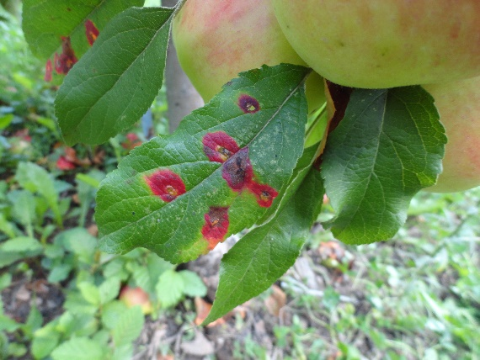
How do the Dataset images look?

Slide 8
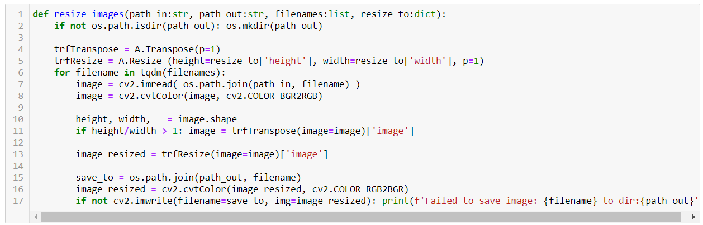
Data Pre-Processing – Rescaling images
1.) Since we load and train the CNN model at the same time, it takes more time to load images.
2.) We cannot completely activate the GPU if CPU always takes times to load the high-resolution images. This results in breakage of the continuity and affects proper GPU utilization.
We downscaled the (4000,3000)px images to (256,256)px

Slide 9
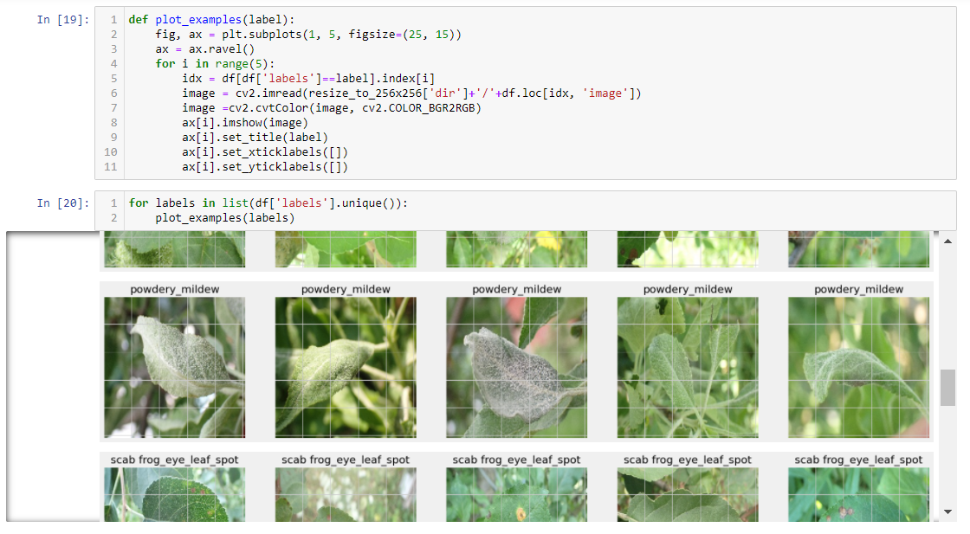
Data Pre-Processing – Rescaling images
After we downscaled the images, we stored them locally in a folder which we can access later when compiling and fitting the model.

Slide 10
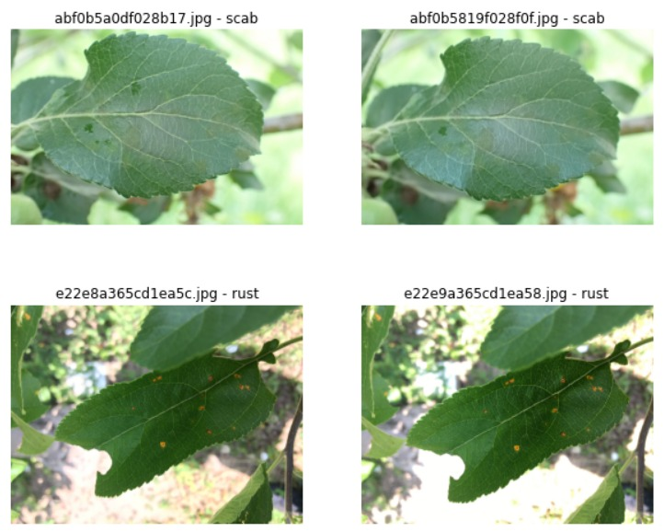
Data Pre-Processing – Duplicates?
Duplicates are always harmful for training process (Image Hash) – differently labeled duplicates produce noise in the dataset, while equally labeled duplicates lead to data leakage.

Slide 11
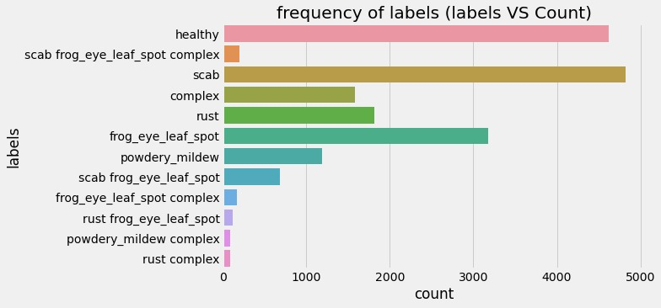
Data Pre-Processing – Volume of Each class
Some of these labels are just a combination of multiple diseases classified to one leaf.

Slide 12
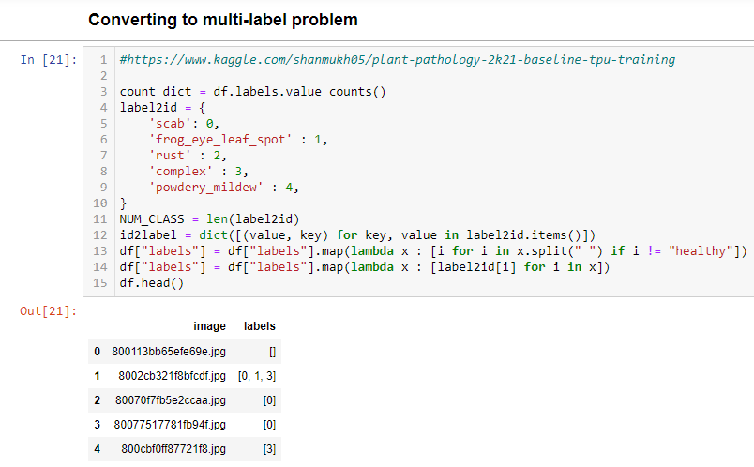
Data Pre-Processing – Encoding Output
We then encoded our categorical labels to numbers before modeling the data.

Slide 13
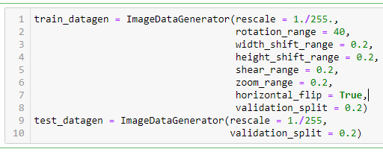
Data Pre-Processing – Data Augmentation
The keras’ ImageDataGenerator class provides the image augmentation functionality which we used to expand the training dataset (not the validation set) to improve the performance and ability of the model to generalize.
Transformations including a range of operations like re-scaling, rotation, width and height shift, zoom and flip were considered in our case.
Notes:
Data augmentation is a strategy that enables practitioners to significantly increase the diversity of data available for training models, without actually collecting new data. Data augmentation techniques such as cropping, padding, and horizontal flipping are commonly used to train large neural networks.

Slide 14
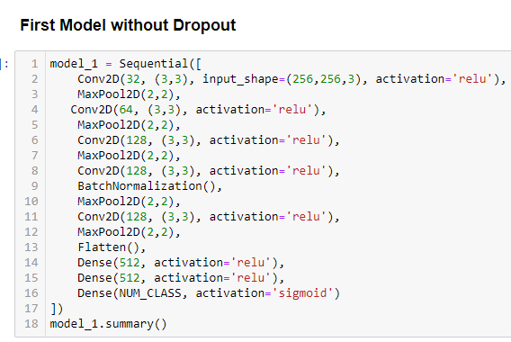
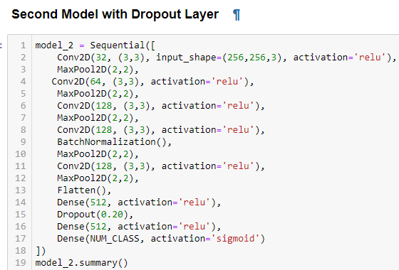
Machine Learning Algorithms
We first decided that our baseline - sequential CNN architecture should include a Batch Normalization layer to help speed up the training.
To specifically understand the effect of Regularization on the model’s performance, we trained the same model twice

Slide 15
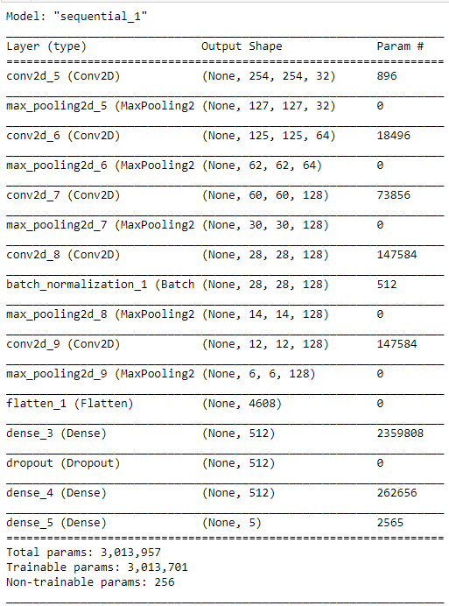
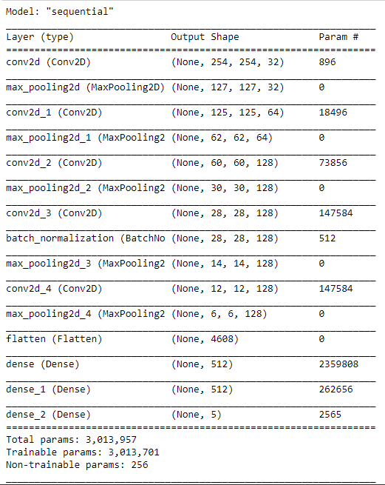
Machine Learning Algorithms

Slide 16
Machine Learning Algorithms – How did we compile?
Adam Optimizer
Learning Rate – 0.001
Momentum & RMSprop term were as per the recommendations from Adam paper
Minibatch Size
128
Loss
Binary Cross Entropy
Evaluation Metric
Accuracy & F1 Score

Slide 17
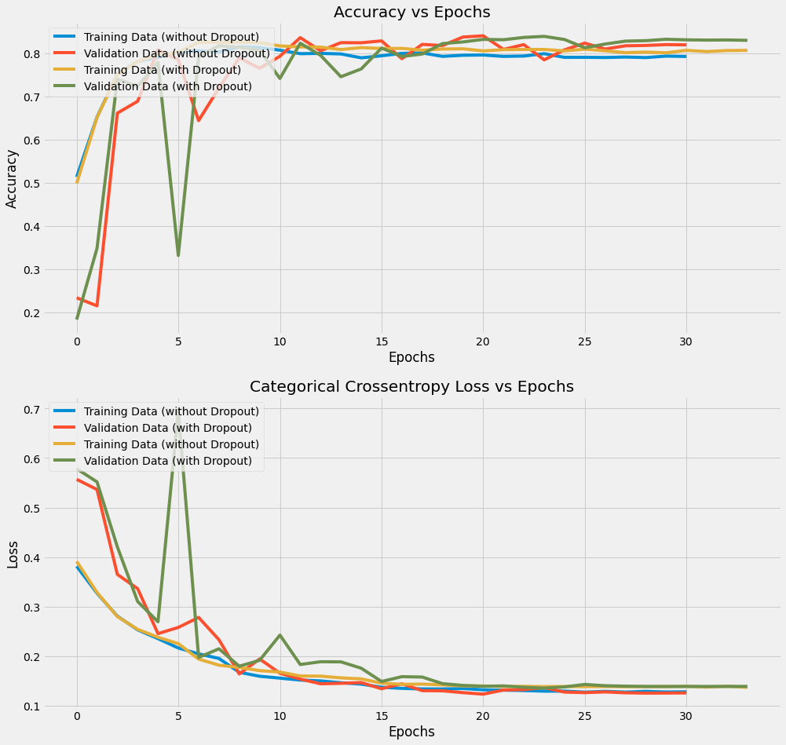
Results of the baseline model? Accuracy

Slide 18
Results of the baseline model? F1-Score

Slide 19
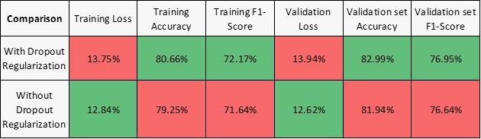
Results of the baseline model? Combined comparison
NEXT STEP:-
Comparing these results with two Off-the-shelf Classic CNN architectures trained using Transfer Learning:-
1.) InceptionResNetV2
2.) EfficientNetB1

Slide 20
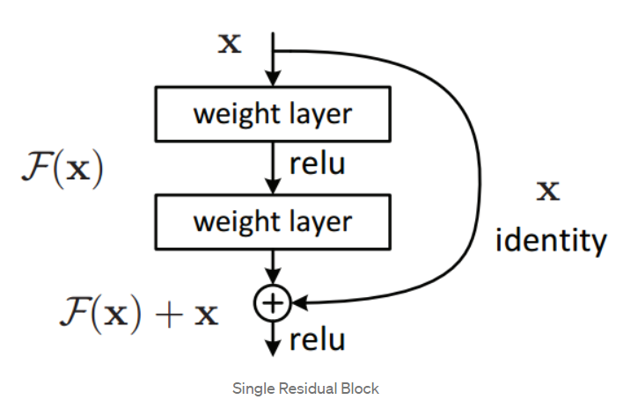
Why Inception ResNet V2?
A Network architecture created with an intention to train very Deep Neural Networks.
Two main highlights of this Architecture:-
1.) Residual Blocks
2.) Inception Bottleneck layer
Residual Blocks?
A residual block is simply when the activation of a layer is fast-forwarded to a deeper layer in the neural network.
residual blocks allows the flow of memory (or information) from initial layers to last layers.

Slide 21
Why Inception ResNet V2?
Why Residual Connections?
1.) Identity function is easy for a residual network to learn.
It is a common belief that the accuracy of NN increases with an increase in the number of Layers. But there is a limit to the number of layers added that result in accuracy improvement.
As the network grows larger, the curse of dimensionality problem becomes prominent. Also, the vanishing and exploding gradient problem has its effect. These cause difficulties for the network to learn basic functions like the “identity” functions.
Skip connections or residual connections help us learn these identity functions even though we increase the number of layers.
Notes:
https://towardsdatascience.com/residual-blocks-building-blocks-of-resnet-fd90ca15d6ec

Slide 22
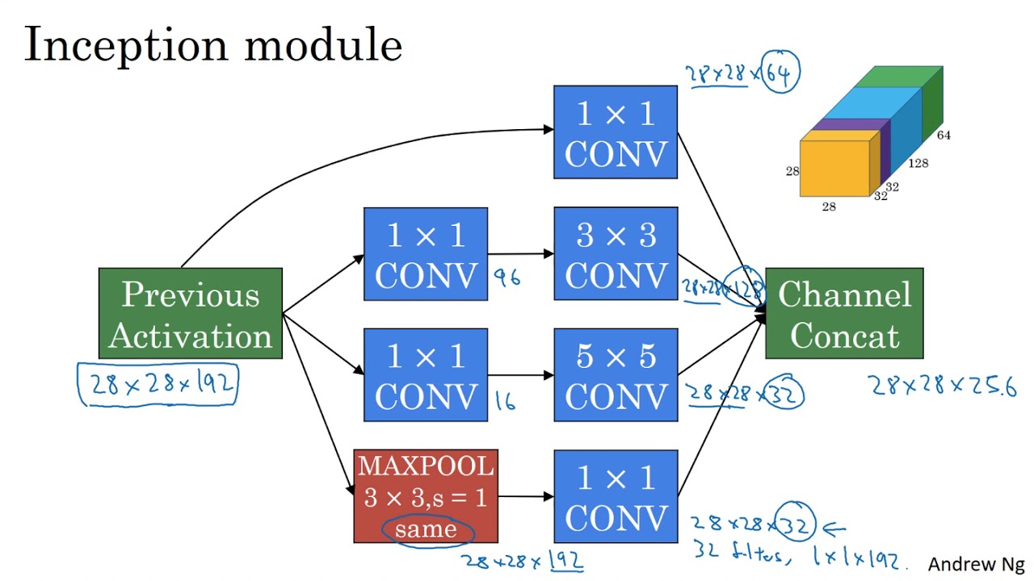
Why Inception ResNet V2?
Inception Bottleneck layer?
1.) The bottleneck in a neural network is just a layer with less neurons than the layer below or above it..
2.) In a CNN (such as Google's Inception network), bottleneck layers are added to reduce the number of feature maps (aka "channels") in the network, which otherwise tend to increase in each layer. This is achieved by using 1x1 convolutions with less output channels than input channels.
Why an Inception Bottleneck layer?
A bottleneck layer helps in reducing the computation steps. Therefore, increasing the speed to train the network.
Notes:
Known to reduce the computation by 10 times as per the original paper on Inception Network.
Refer to this link for more info on inception bottle neck layers - https://towardsdatascience.com/neural-network-architectures-156e5bad51ba

Slide 23
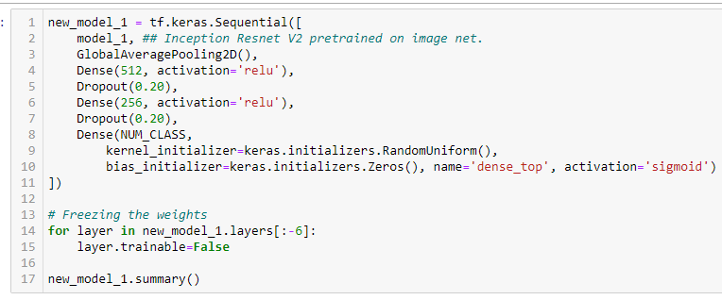
Transfer Learning:-
We borrowed the weights of Inception ResNet v2 pretrained on the “ImageNet” data. Freezed these tuned weights and removed the output layer
Replaced this output with a few dense and pooling layers followed by a new output layer.
Our task was only to train these last few extra layers and finetune the whole model to our FGVC-2021 dataset.
Notes:
A gentle introduction to transfer learning - https://machinelearningmastery.com/transfer-learning-for-deep-learning/

Slide 24
How did we train this model?:-
Adam Optimizer
Loss
Minibatch Size
RMS prop parameter
Evaluation Metric
Momentum Term
Using the same Optimizer (Adam), learning rate, Loss and evaluation metric as before, we train this new borrowed architecture. But before we look at the model evaluation. Let’s look at the third model we trained using transfer learning
- EfficientNet B1 architecture

Slide 25
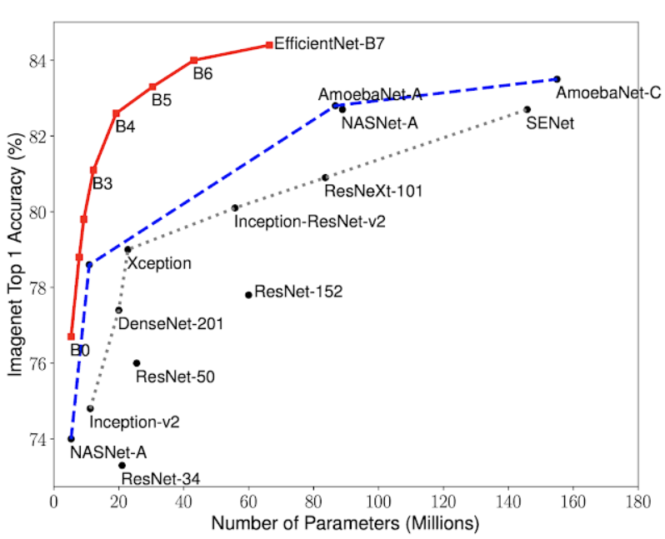
Why EfficientNetB1?
As per the GoogleAI blog, EfficientNet models achieve both higher accuracy and better efficiency over existing CNNs (On ImageNet dataset), reducing parameter size and FLOPS by an order of magnitude.
It is based on more principled method to scale up a CNN to obtain better accuracy and efficiency.
By providing significant improvements to model efficiency, Google expect EfficientNets could potentially serve as a new foundation for future computer vision tasks.
https://ai.googleblog.com/2019/05/efficientnet-improving-accuracy-and.html
Notes:
https://ai.googleblog.com/2019/05/efficientnet-improving-accuracy-and.html

Slide 26
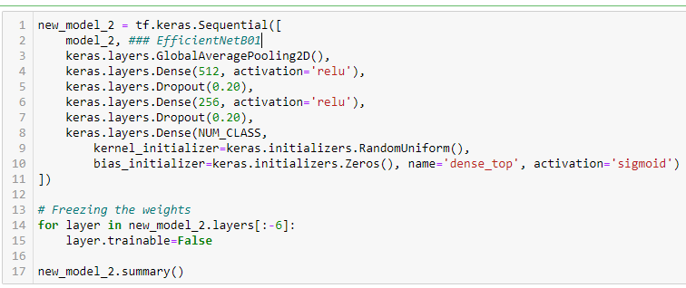
Transfer Learning:-
We borrowed the weights of EfficientNetB01 pretrained on the “ImageNet” data. Freezed these tuned weights and removed the output layer
Replaced this output with a few dense and pooling layers followed by a new output layer.
Our task was only to train these last few extra layers and finetune the whole model to our FGVC-2021 dataset.
Notes:
A gentle introduction to transfer learning - https://machinelearningmastery.com/transfer-learning-for-deep-learning/

Slide 27
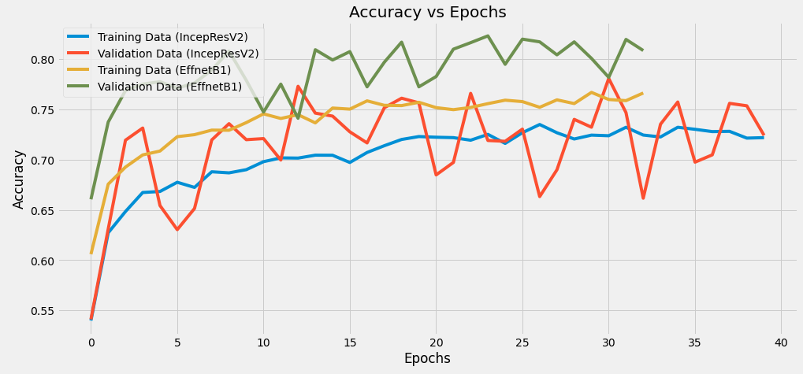
InceptionResNetV2 VS EffecientNetB1 on FGVC8 2021 apple foliar disease dataset
EfficientNetB1 performed better than InceptionResNetV2. In both the cases, however, we notice that accuracy flattens quickly.

Slide 28
InceptionResNetV2 VS EffecientNetB1 on FGVC8 2021 apple foliar disease dataset
Our baseline model performed better than the models trained through transfer learning. Previous year, off-the-shelf models achieved close to 97% F1 score. In fact, even in our case we expected our models to outperform the base line model but observed the opposite.
Comparison | Training Loss | Training Accuracy | Training F1-Score | Validation Loss | Validation set Accuracy | Validation set F1-Score
With Dropout Regularization | 13.75% | 80.66% | 72.17% | 13.94% | 82.99% | 76.95%
Without Dropout Regularization | 12.84% | 79.25% | 71.64% | 12.62% | 81.94% | 76.64%
Transferred Model | Train Loss | Train Accuracy | Train F1 Score | Validation Loss | Validation Accuracy | Validation F1 Score
InceptionResNet V2 | 23.10% | 73.22% | 63.26% | 21.15% | 74.68% | 68.74%
EffecientNetB1 | 19.42% | 76.63% | 68.27% | 17.62% | 80.86% | 73.02%

Slide 29
InceptionResNetV2 VS EffecientNetB1 on FGVC8 2021 apple foliar disease dataset
Reason for this, we believe could probably be:-
1.) Not the right choice of trainable layers added after the transferred network.
2.) Network too complex and data not sufficient. But this might not be true because 97% F1 score was observed on transferred learning models last year.
3.) Not enough Data Augmentation.
4.) Extreme downscaling of images.
5.) Lack of domain knowledge that was probably used to better preprocess the data.

Slide 30
Future Directions and References.
**1.) Data is clearly skewed. Some classes have way more images than other. Stratified Sampling could also improve any model’s accuracy by a considerable amount.
2.) Understanding the right way, if any, to scale a CNN architecture to obtain better accuracy and efficiency.
3.) A grid search through various hyperparameters.
[1] C. Szegedy, W. Liu, Y. Jia, et al., “Going deeper with convolutions,” in Proceedings of the IEEE conference on computer vision and pattern recognition, 2015, pp. 1–9.
[2] K. He, X. Zhang, S. Ren, and J. Sun, “Deep residual learning for image recognition,” in Proceedings of the IEEE conference on computer vision and pattern recognition,
2016, pp. 770–778.
[3] C. Garbin, X. Zhu, and O. Marques, “Dropout vs. batch normalization: An empirical study of their impact to deep learning,” Multimedia Tools and Applications, pp. 1–39,
2020.
[4] N. Srivastava, G. Hinton, A. Krizhevsky, I. Sutskever, and R. Salakhutdinov, “Dropout: A simple way to prevent neural networks from overfitting,” The journal of machine learning research, vol. 15, no. 1, pp. 1929–1958, 2014.
Notes:
1st paper is the original paper on Inception network
2nd paper is the original paper on the residual connection
3rd paper is another paper on when to use dropout and batch Norm
4th Paper is the original paper on Dropout Regularization.

Slide 31
THANK YOU

